Slide 1
Employee Management System
Submitted By:
Vaibhav Kailash Kaingade(Emp Id:816033)
Puja Siddhaling Vibhute(Emp Id:814916)
Mentor:
Thaneshwara M.

Slide 2
Introduction :
Employee Management System is developed to maintain the details of employees working in any organization.
It maintains the information about the personal and official details of the employees.

Slide 3
Objective of the Project:
The main objective of the system is to computerize the maintenance of the employee details .
To develop an well-designed database to store employee information.

Slide 4
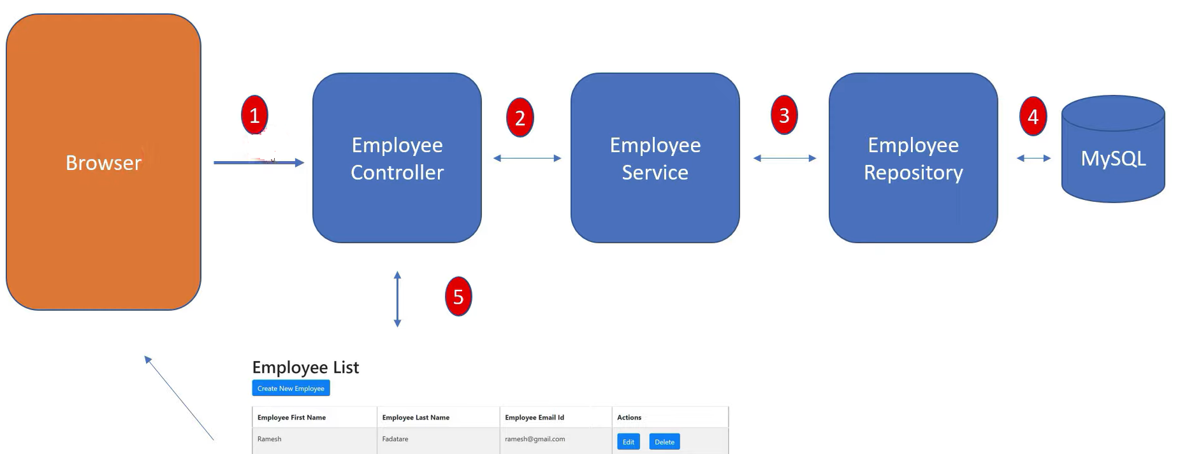
Structure of the Project:
.

Slide 5
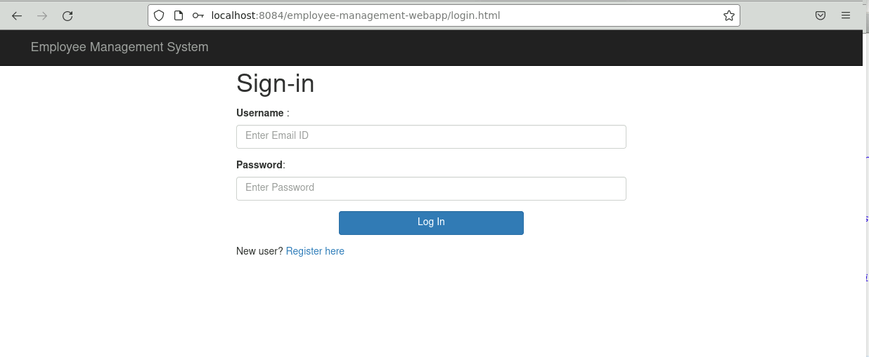
Login Page:

Slide 6
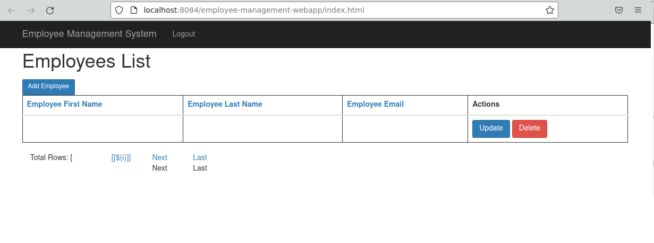
Index Page:
.

Slide 7
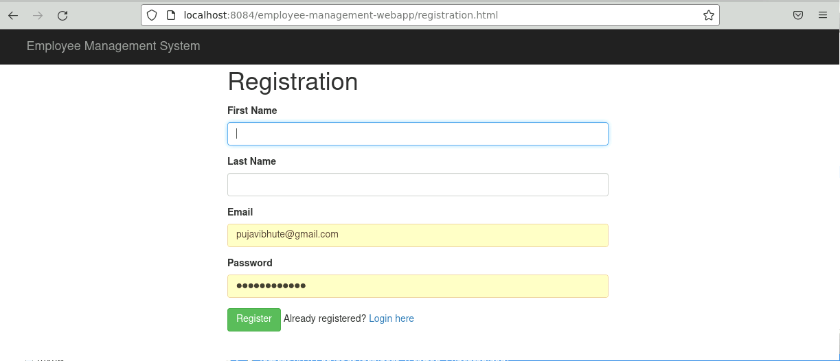
New User Registration:
.

Slide 8
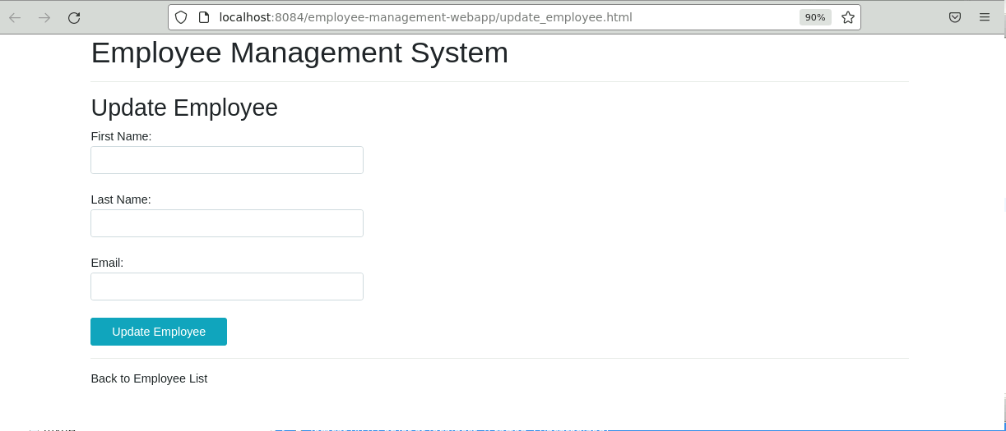
Update User:
.

Slide 9
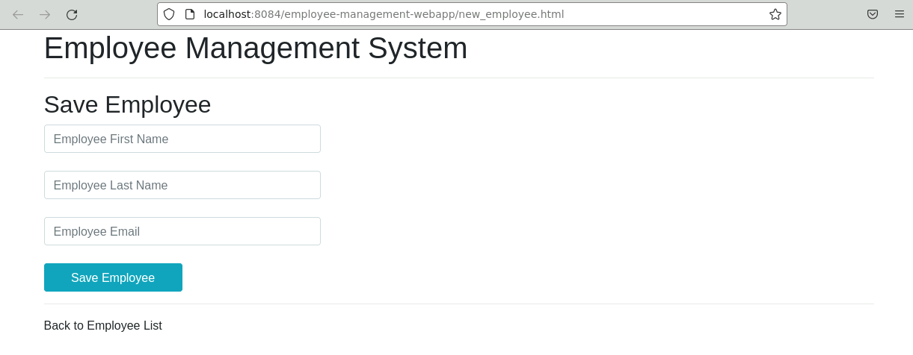
Save Employee:

Slide 10
Requirements of project:
Spring Boot 2.2.6+
Spring Framework 5.2.5+
Maven 3.2+
Java 11
Spring data JPA(Hibernate)
Thymeleaf

Slide 11
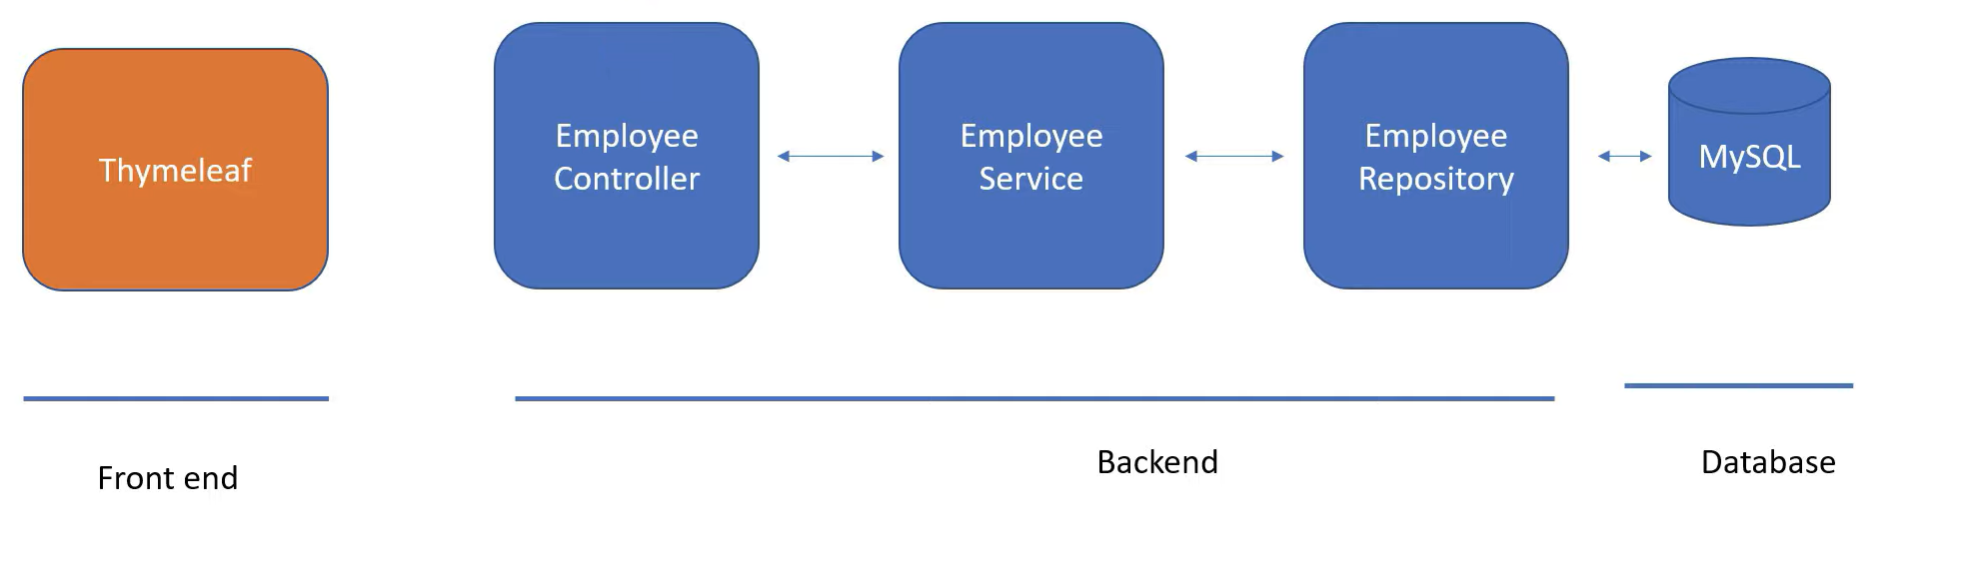
.

Slide 12
Features of Project:
EMS is platform independent system.Provides password facility fordifferent users to ensures high level of security.
Single database management system.
It is completely user friendly Employee management software.
More efficient and reliable.

Slide 13
Limitation Of Project:
Every time for new service we have to put data manualy
Work will be delayed due to manual entry
No online money transfer available on application

Slide 14
.
Thank You!!

